Slide 1
Customer analysis system
V.V.ANJAN SAI KAMAL
RA2111028010203

Slide 2
UML DIAGRAMS DESCRIPTION
Unified Modeling Language (UML) diagrams are crucial tools for visualizing, specifying, constructing, and documenting the artifacts of a software-intensive system. When it comes to the design and analysis of a customer analysis system, UML diagrams play a vital role in capturing and organizing complex system components and their relationships. Several types of UML diagrams can be particularly useful in the context of a customer analysis system:
1. Use Case Diagrams: Use case diagrams help to illustrate the various ways in which users interact with the system. They can outline the different functionalities provided by the customer analysis system, such as customer data management, analysis processes, and reporting functionalities.
2. Class Diagrams: Class diagrams depict the static structure of the system by showing classes, their attributes, and the relationships between them. In the context of a customer analysis system, class diagrams can represent entities like customers, customer segments, analysis tools, and data processing components.
3. Sequence Diagrams: Sequence diagrams showcase the interaction between objects over time. For a customer analysis system, sequence diagrams can illustrate the flow of activities between different system components during processes like data collection, analysis, and generation of customer insights.

Slide 3
4. Activity Diagrams: Activity diagrams provide a graphical representation of workflows within the system. They can be used to depict the various steps involved in customer data analysis, such as data collection, preprocessing, analysis, and visualization of results.
5. State Machine Diagrams: State machine diagrams describe the different states that a particular object can be in and how it transitions between those states. These diagrams can be employed to illustrate the various stages that customer data goes through during the analysis process, such as data input, validation, processing, and output.
By utilizing these UML diagrams, developers and stakeholders can gain a comprehensive understanding of the customer analysis system, its functionalities, and the interactions between its different components. This visual representation facilitates effective communication, aids in the identification of potential issues, and assists in the creation of a robust and efficient system for customer analysis.

Slide 4
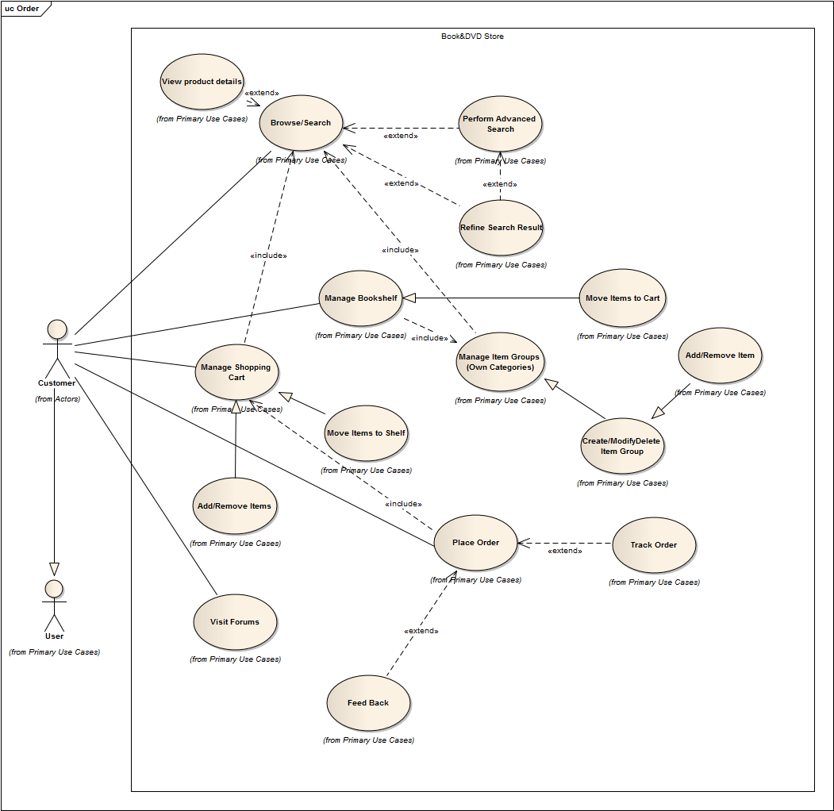
USECASE DIAGRAM

Slide 5
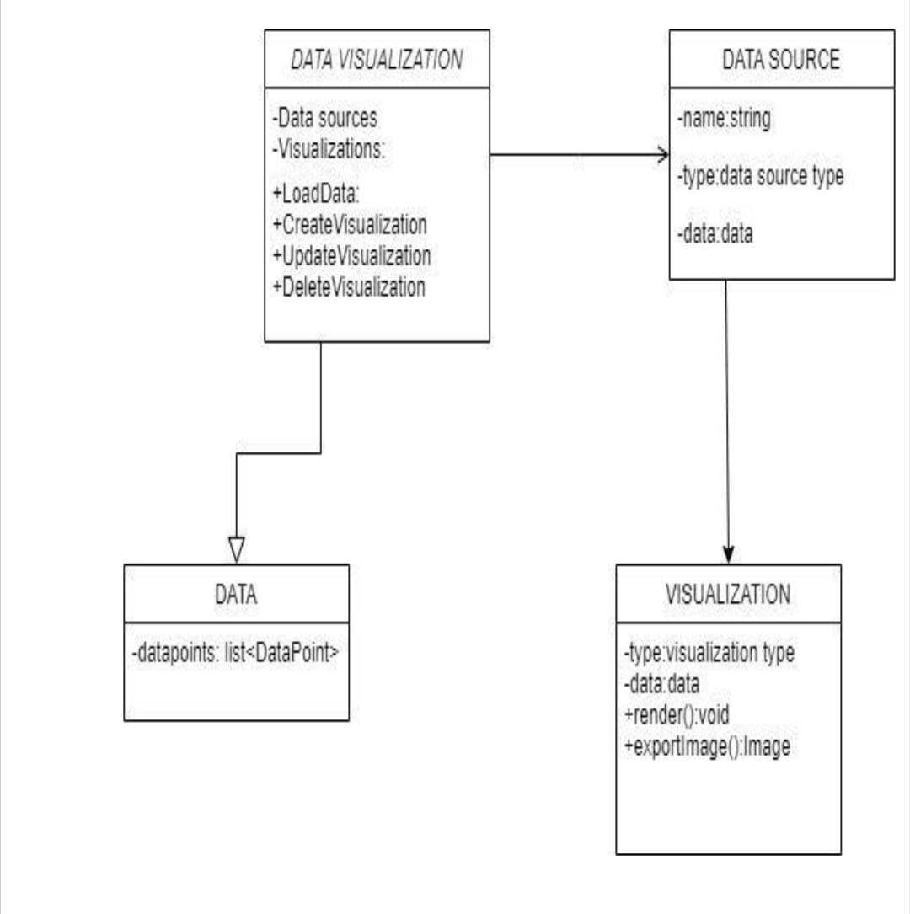
CLASS DIAGRAM

Slide 6
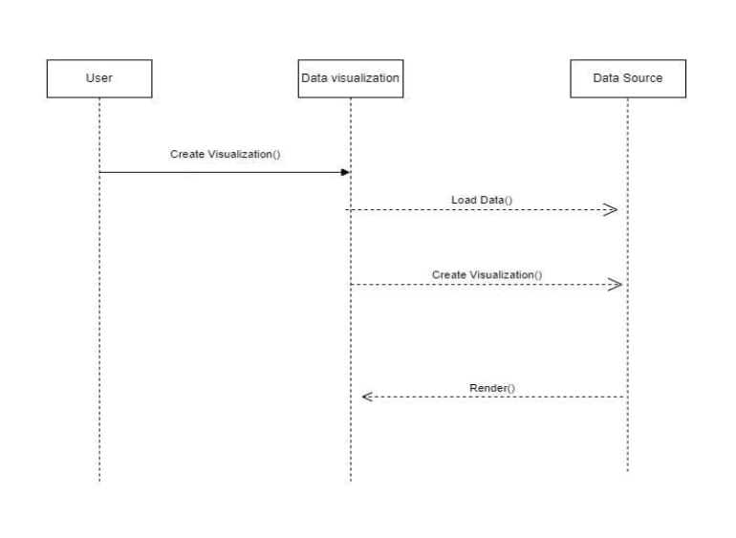
SEQUENCE DIAGRAM

Slide 7
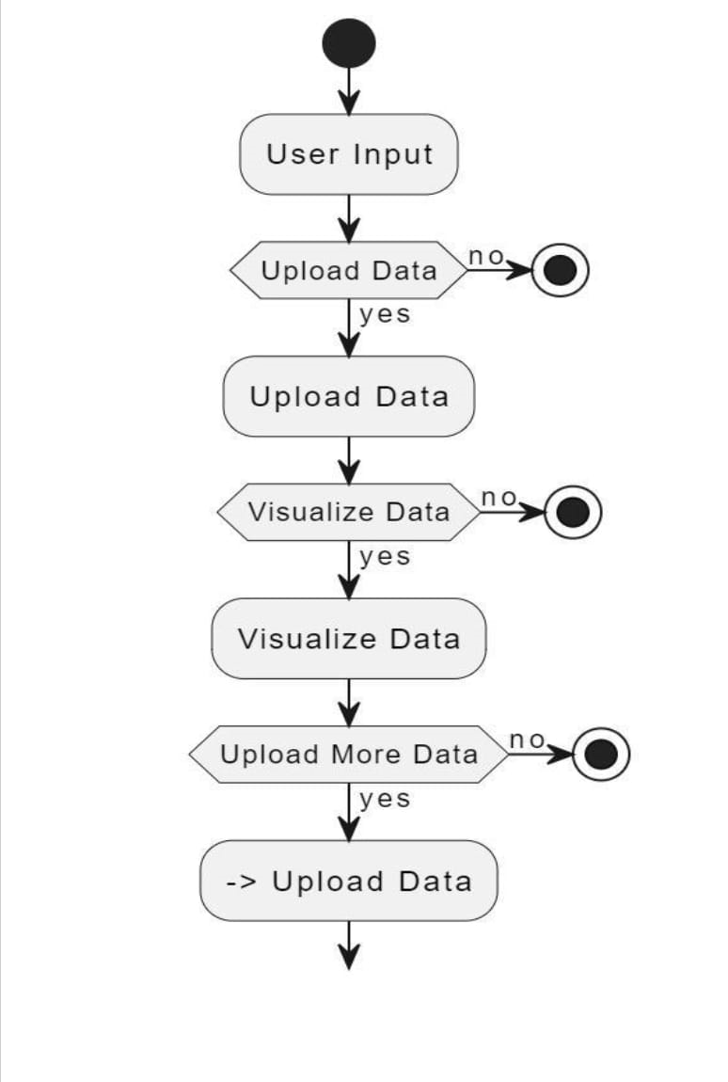
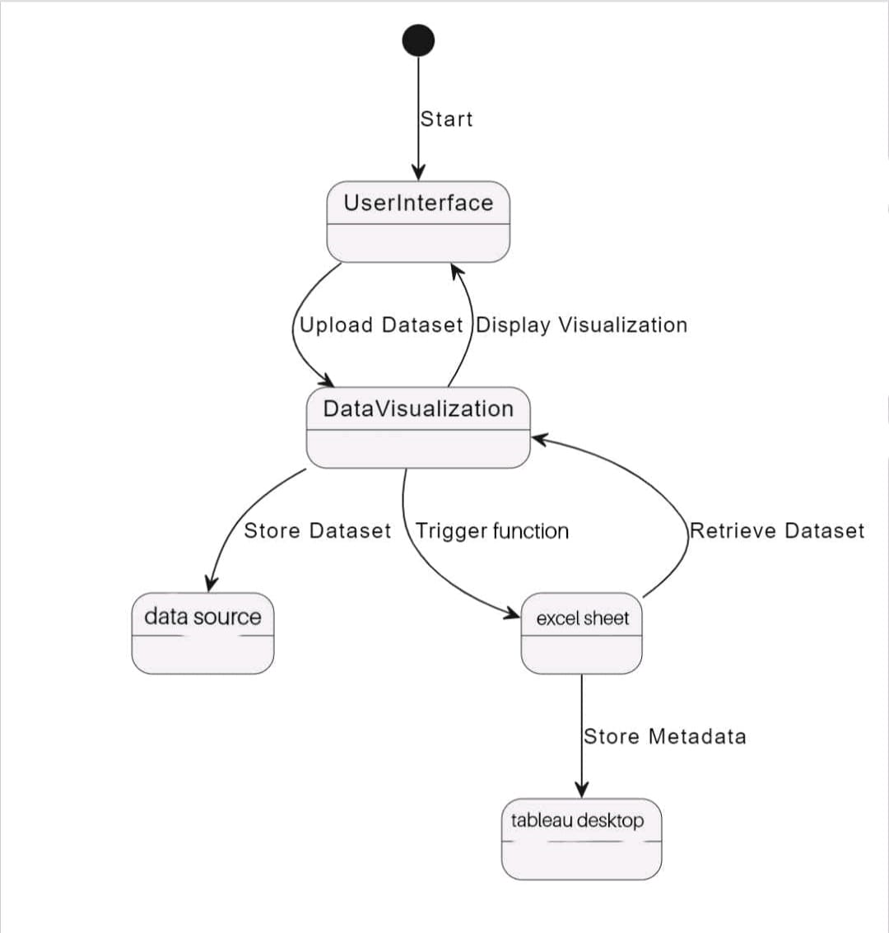
ACTIVITY DIAGRAM
STATE DIAGRAM

Slide 8
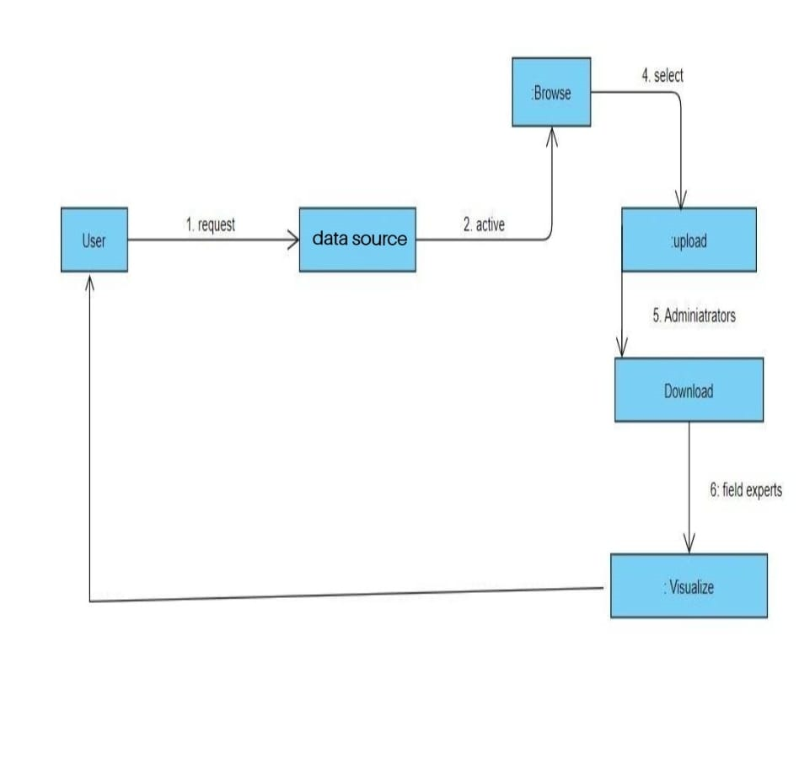
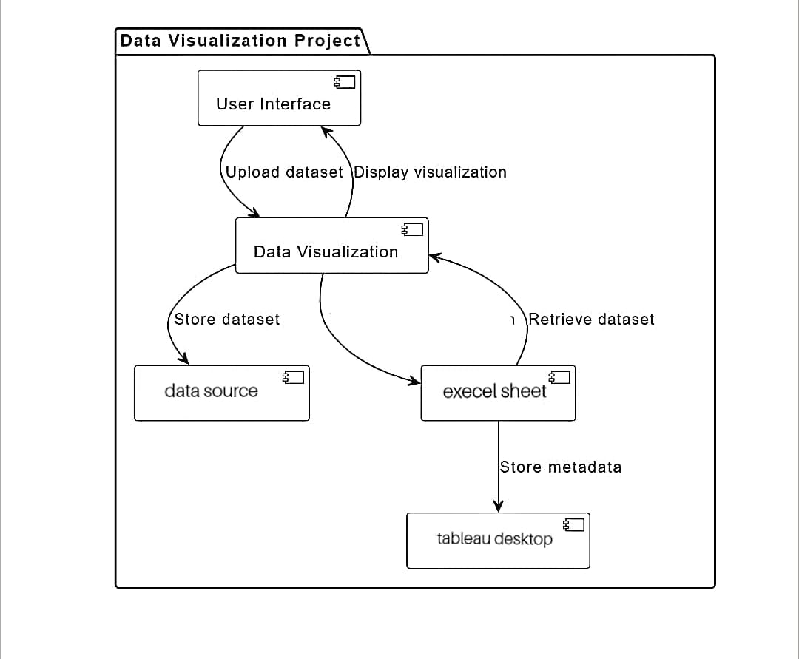
COLLEBORATION DIAGRAM
COMPONENT DIAGRAM

Slide 9
THANK YOU

